Slide 1
EPA
Effective Parking Application

Slide 2
The Problem
Parking on RIT campus is a pain. Circling around to find a spot is tiring and often a waste of time.
We aim to fix this problem with image recognition software and a phone app

Slide 3
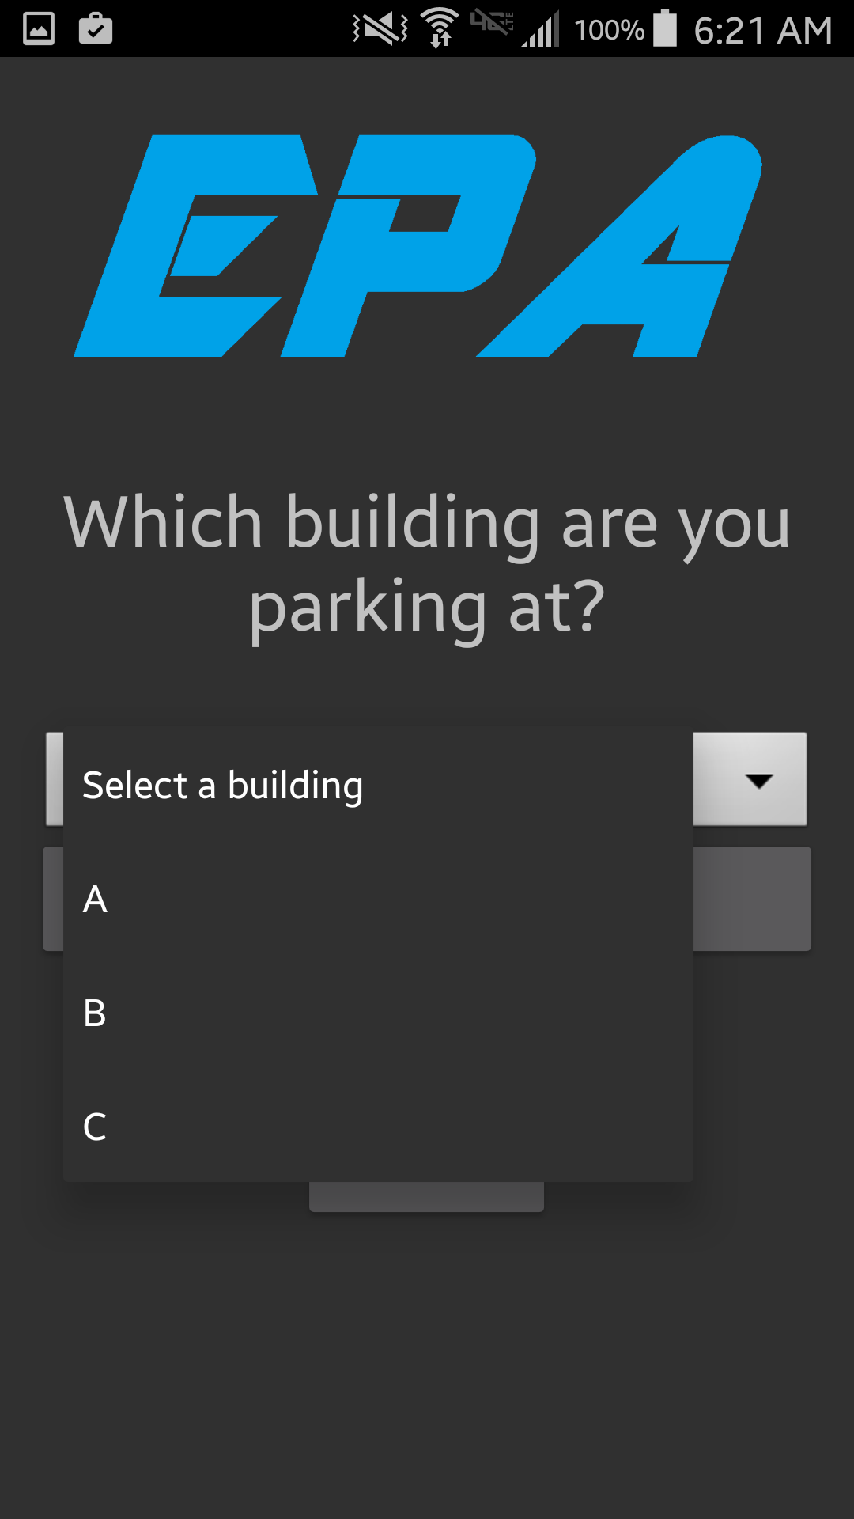
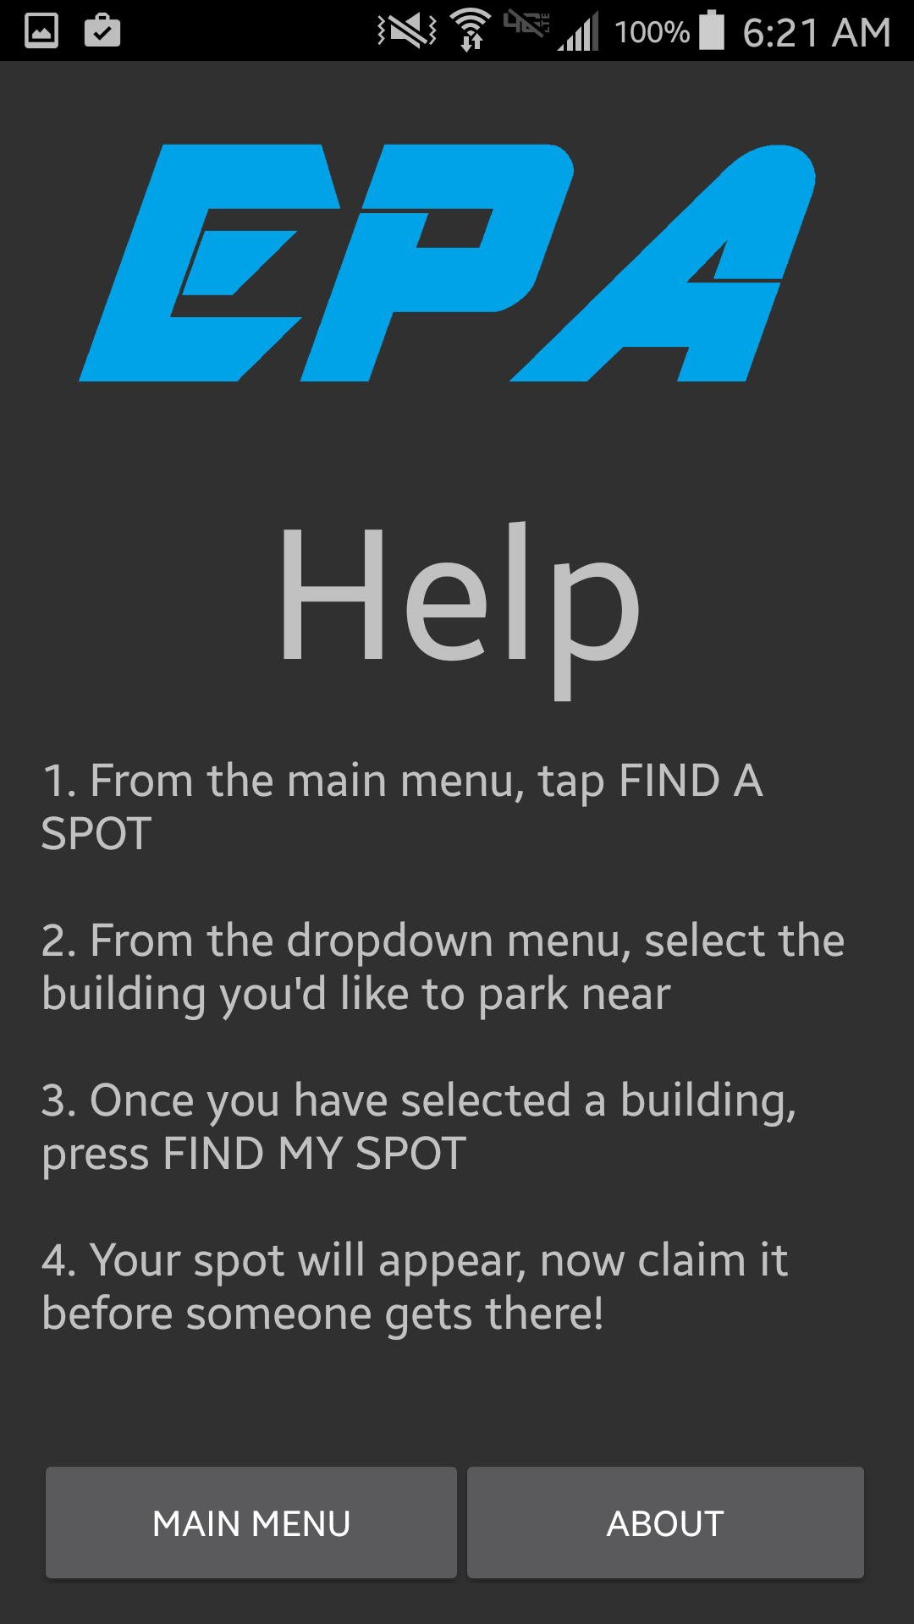

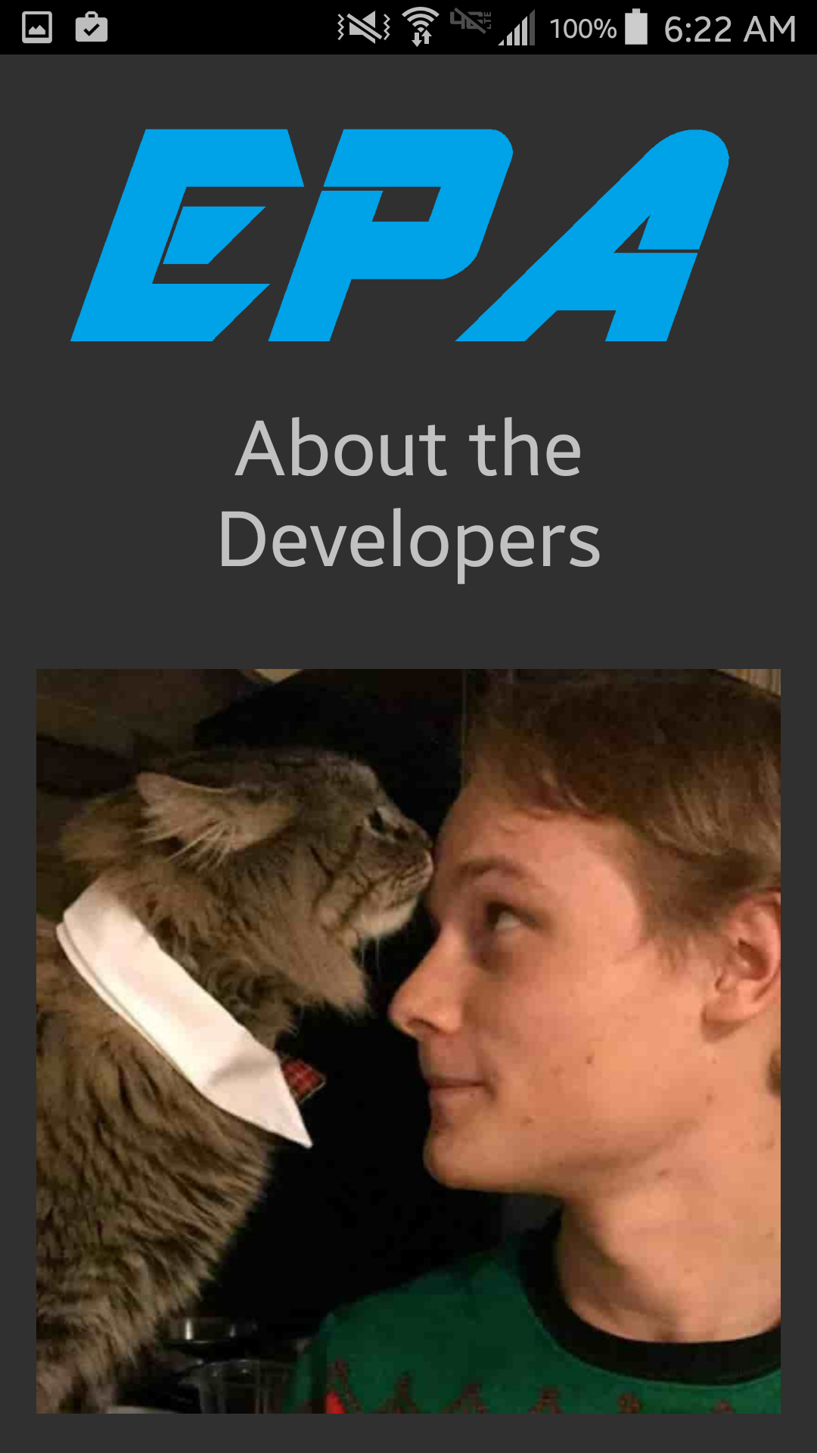
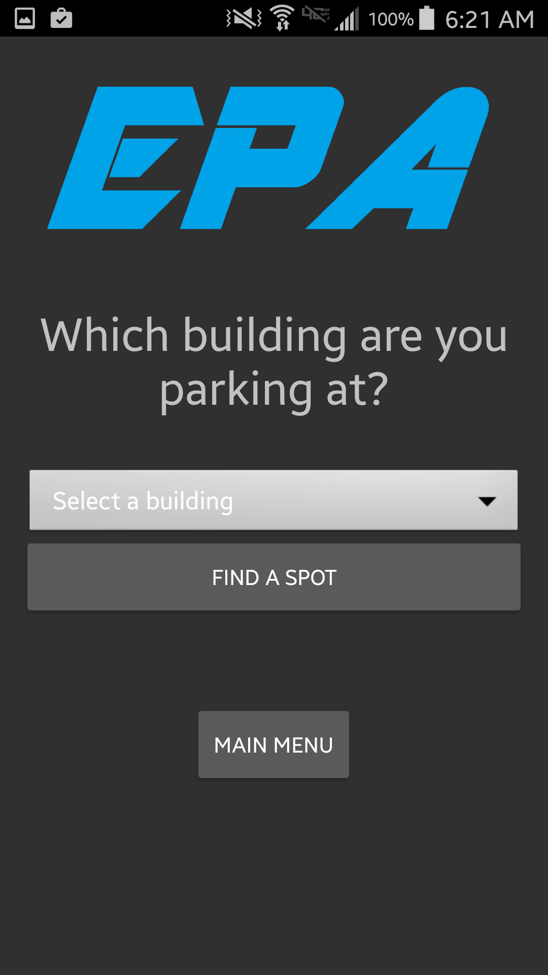

The App

Slide 4
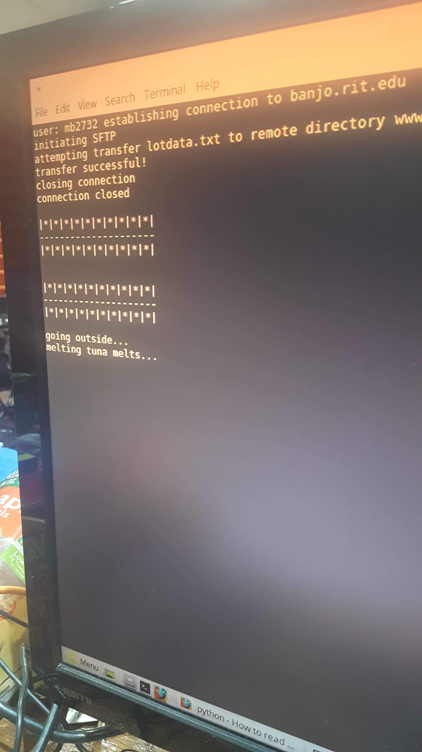
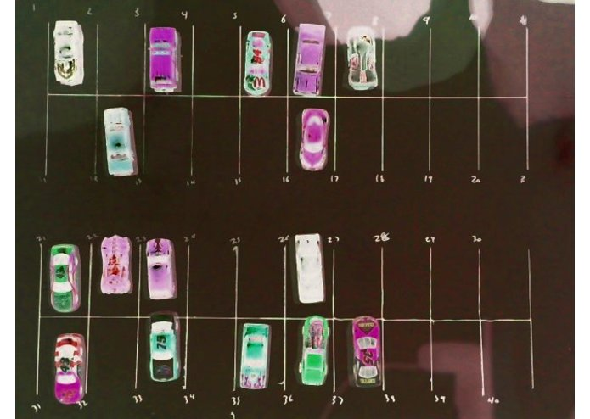
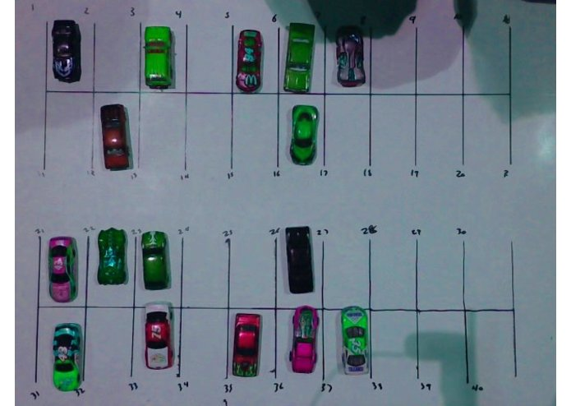
The Image Recognition

Slide 5
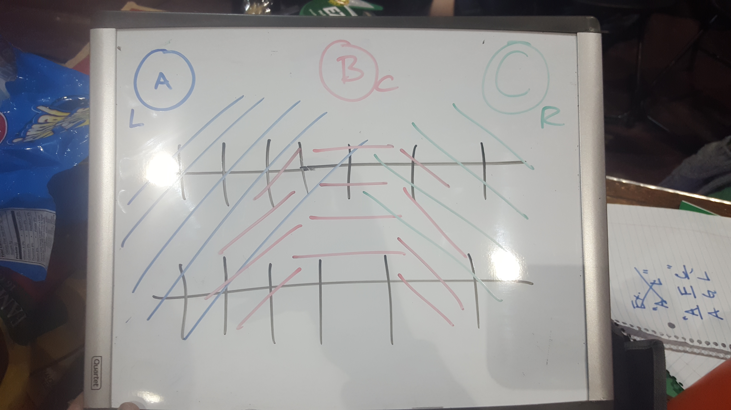
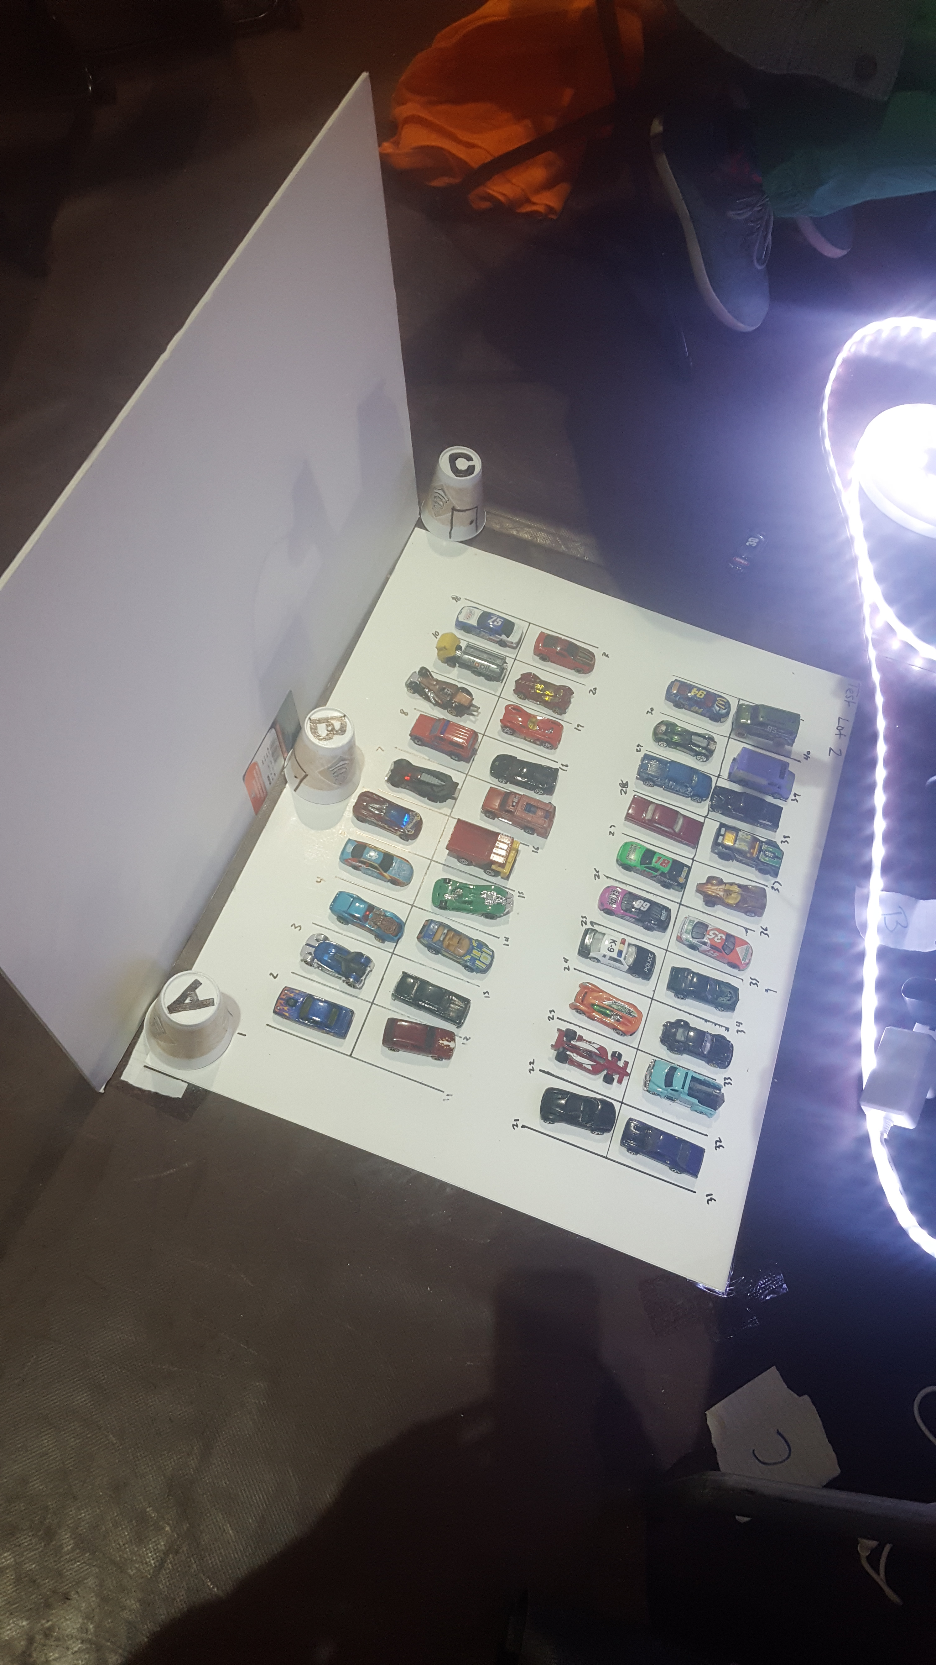
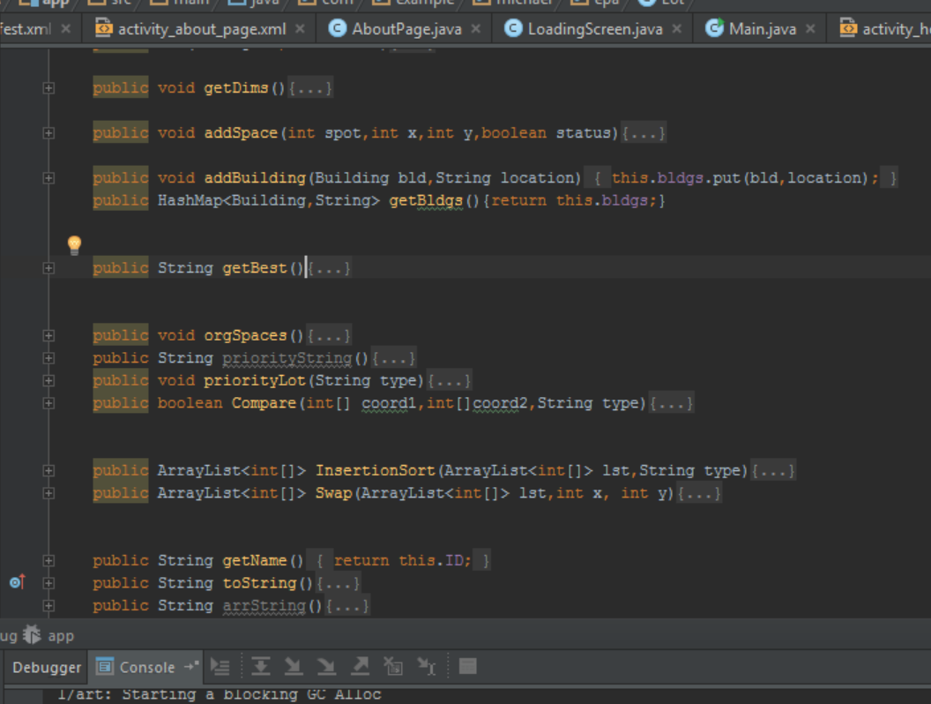
The Logic

Slide 6
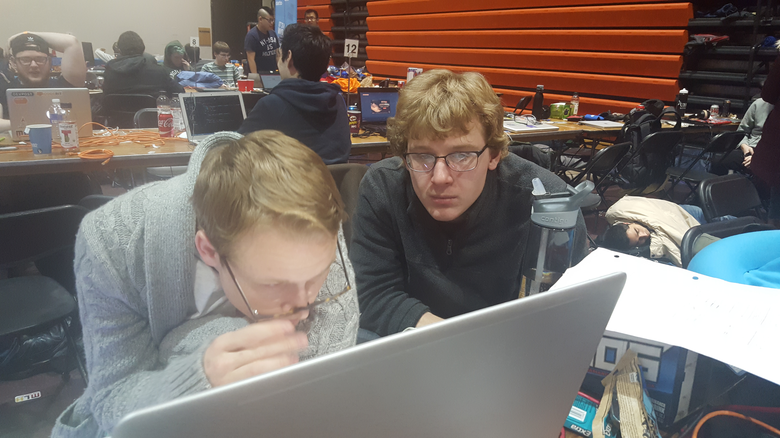
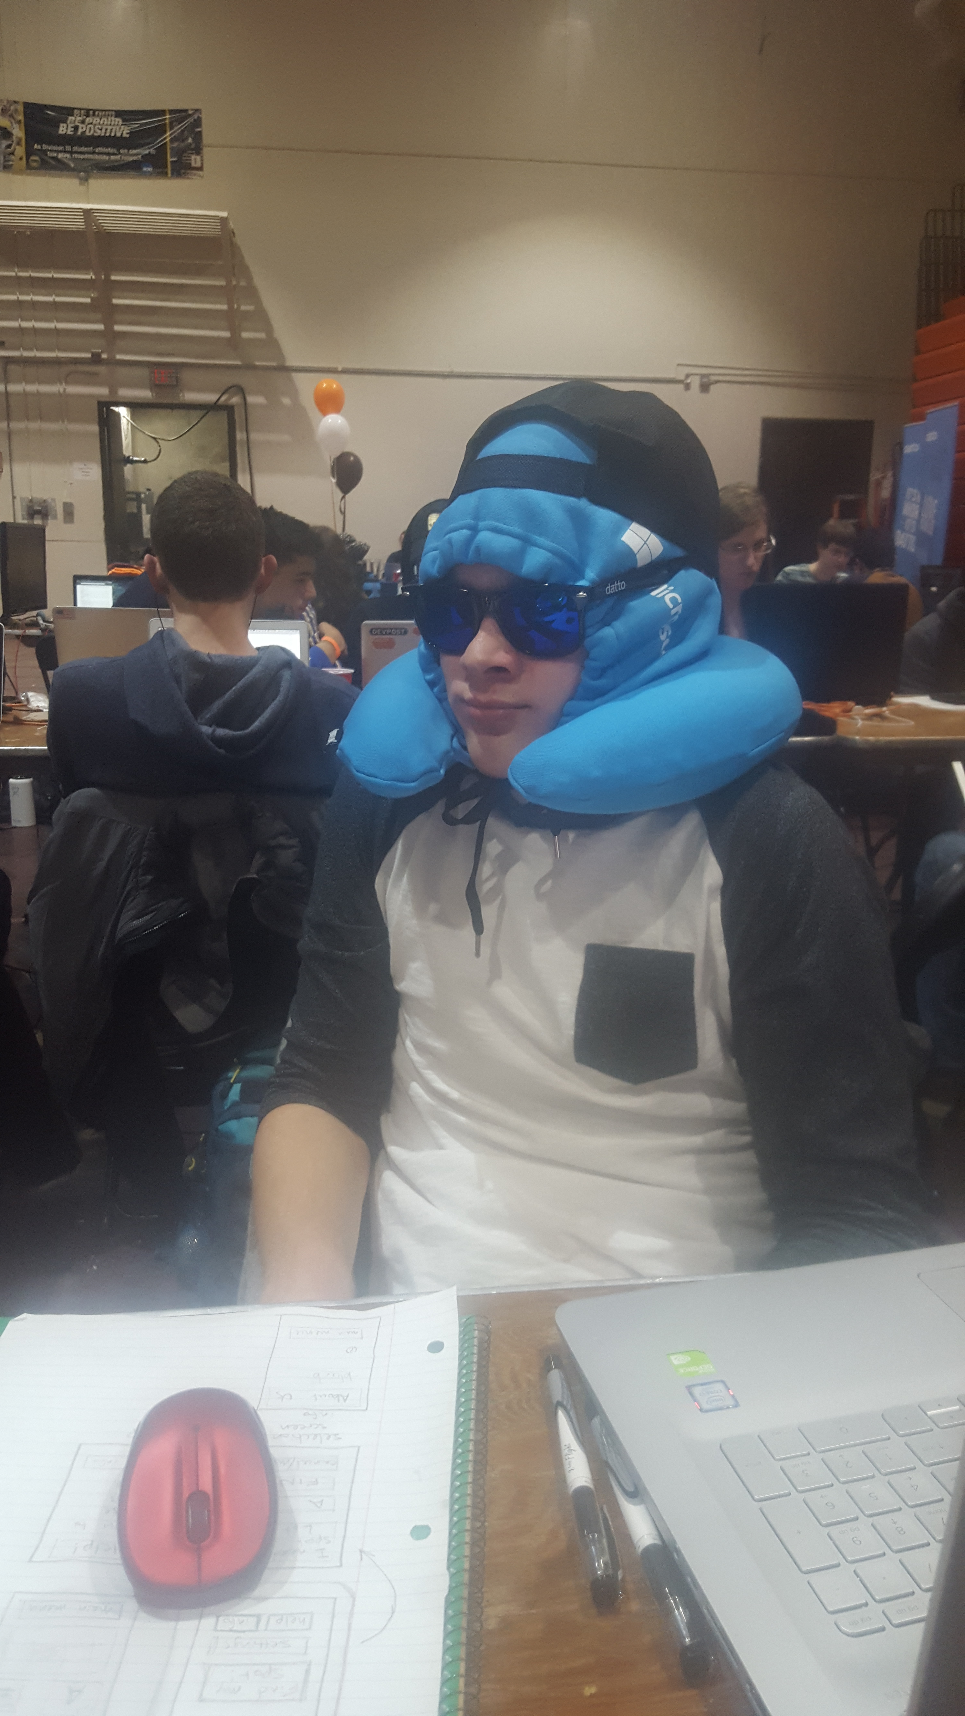
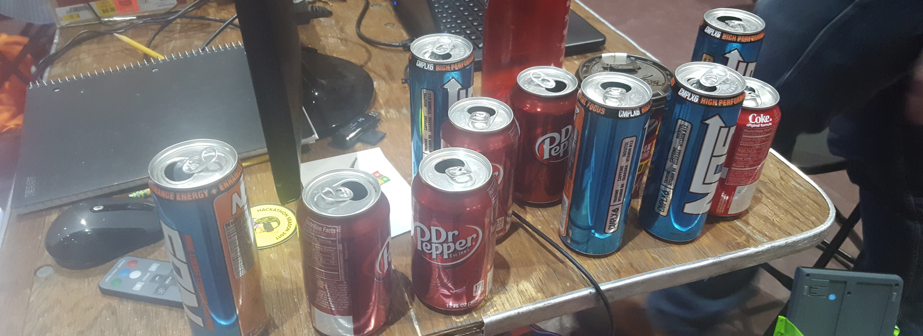
The Experience

Slide 7
Challenges
Light Colored Cars
Shadows
Cyclic Logic
New Languages
New IDE (Android Studio)
Middle-of-the-night Brain Power

Slide 8
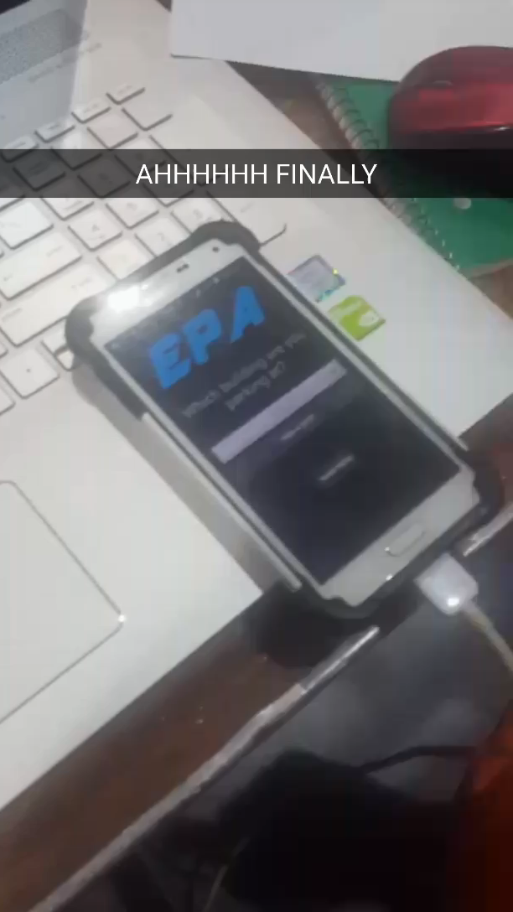
But it’s worth it when…

Slide 9
Try it yourself!
Feel free to play with the cars and the available android phones loaded with the app.

